Slide 1
Lecture 05 Divide and Conquer (quicksort)
CSE373: Design and Analysis of Algorithms

Slide 2
Quicksort
Follows the divide-and-conquer paradigm.
Divide: Partition (separate) the array A[p..r] into two (possibly empty) subarrays A[p..q–1] and A[q+1..r].
Each element in A[p..q–1] ≤ A[q].
A[q] ≤ each element in A[q+1..r].
Index q is computed as part of the partitioning procedure.
Conquer: Sort the two subarrays by recursive calls to quicksort.
Combine: The subarrays are sorted in place – no work is needed to combine them.
How do the divide and combine steps of quicksort compare with those of merge sort?

Slide 3
Pseudocode
PARTITION(A, p, r)
x = A[r]
2. i = p-1
3. for j = p to r – 1
4. if A[j] ≤ x
5. i = i + 1
6. exchange A[i] with A[j]
7. exchange A[i + 1] with A[r]
8. return i + 1
QUICKSORT(A, p, r)
1. if p < r then
2. q = PARTITION(A, p, r);
3. QUICKSORT (A, p, q – 1);
4. QUICKSORT (A, q + 1, r)
A[p..r]
5
A[p..q – 1]
A[q+1..r]
Partition
5
≤ 5
≥ 5

Slide 4
Example
p r
initially: 2 5 8 3 9 4 1 7 10 6 note: pivot (x) = 6
i j
next iteration: 2 5 8 3 9 4 1 7 10 6
i j
next iteration: 2 5 8 3 9 4 1 7 10 6
i j
next iteration: 2 5 8 3 9 4 1 7 10 6
i j
next iteration: 2 5 3 8 9 4 1 7 10 6
i j
PARTITION(A, p, r)
x = A[r]
2. i = p-1
3. for j = p to r – 1
4. if A[j] ≤ x
5. i = i + 1
6. exchange A[i] with A[j]
7. exchange A[i + 1] with A[r]
8. return i + 1

Slide 5
Example (Continued)
next iteration: 2 5 3 8 9 4 1 7 10 6
i j
next iteration: 2 5 3 8 9 4 1 7 10 6
i j
next iteration: 2 5 3 4 9 8 1 7 10 6
i j
next iteration: 2 5 3 4 1 8 9 7 10 6
i j
next iteration: 2 5 3 4 1 8 9 7 10 6
i j
next iteration: 2 5 3 4 1 8 9 7 10 6
i j
after final swap: 2 5 3 4 1 6 9 7 10 8
i j
PARTITION(A, p, r)
x = A[r]
2. i = p-1
3. for j = p to r – 1
4. if A[j] ≤ x
5. i = i + 1
6. exchange A[i] with A[j]
7. exchange A[i + 1] with A[r]
8. return i + 1

Slide 6
Partitioning
Select the last element A[r] in the subarray A[p..r] as the pivot – the element around which to partition.
As the procedure executes, the array is partitioned into three (possibly empty) regions.
A[p..i] — All entries in this region are ≤ pivot.
A[i+1..j – 1] — All entries in this region are > pivot.
A[r] = pivot.

Slide 7
Complexity of Partition
PartitionTime(n) is given by the number of iterations in the for loop.
Θ(n) : n = r – p + 1.
PARTITION(A, p, r)
x = A[r]
2. i = p-1
3. for j = p to r – 1
4. if A[j] ≤ x
5. i = i + 1
6. exchange A[i] with A[j]
7. exchange A[i + 1] with A[r]
8. return i + 1

Slide 8
Algorithm Performance
Running time of quicksort depends on whether the partitioning is balanced or not.
Best case: occurs when the recursion tree is always balanced
Worst case: occurs when the recursion tree is always unbalanced
Average case: computed by using expected value of running time assuming that the pivot elements are randomly distributed

Slide 9
Best-case Partitioning
Size of each subproblem ≤ n/2.
One of the subproblems is of size ⎣n/2⎦
The other is of size ⎡n/2⎤ −1.
Called a ⎣n/2⎦: (⎡n/2⎤ −1) split
Recurrence for running time
T(n) ≤ 2T(n/2) + PartitionTime(n)
= 2T(n/2) + Θ(n)
T(n) = Θ(n lg n)

Slide 10
Recursion Tree for Best-case Partition
cn
cn
cn/2
cn/2
cn
lg n
cn/4
cn/4
cn/4
cn/4
cn
c
c
c
c
c
c
cn
Total : O(n lg n)

Slide 11
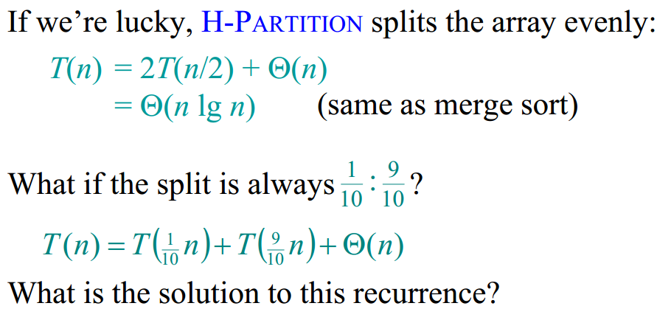
Best-case analysis

Slide 12
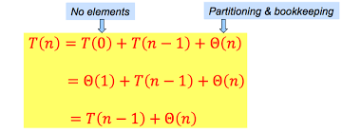
Worst-case of quicksort
Worst-Case Partitioning (Unbalanced Partitions):
Occurs when every call to partition results in the most unbalanced partition.
Partition is most unbalanced when
Subproblem 1 is of size n – 1, and subproblem 2 is of size 0 or vice versa.
pivot ≥ every element in A[p..r – 1] or pivot < every element in A[p..r – 1].
Every call to partition is most unbalanced when
Array A[1..n] is sorted or reverse sorted!
One side of partition always has one element.

Slide 13
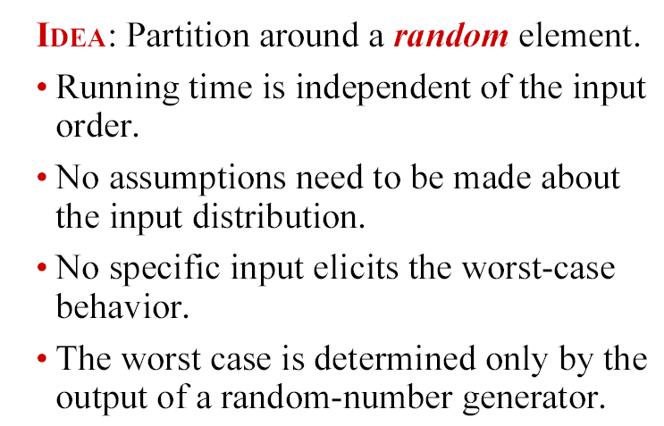
Randomized quicksort
How can we ENSURE that each element of A are equally likely to be the pivot?

Slide 14
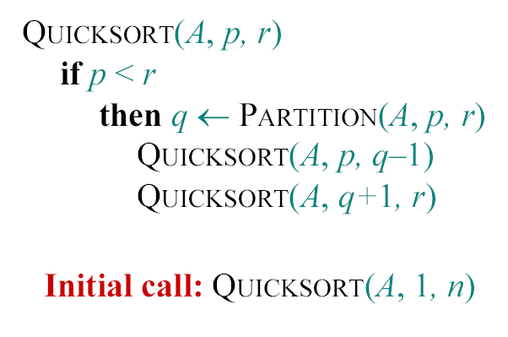
Randomized quicksort
Standard Problematic Algorithm :

Slide 15
Randomized quicksort
RANDOMIZED-PARTITION (A, p, r)
i←RANDOM(p, r)
exchange A[r]↔A[i]
return PARTITION(A, p, r)
RANDOMIZED-QUICKSORT (A,p,r)
if p<r
then q←RANDOMIZED-PARTITION (A, p, r)
RANDOMIZED-QUICKSORT (A, p, q-1)
RANDOMIZED-QUICKSORT (A, q+1, r)
Average and worst case running time of Randomized-QuickSort is the same as that of QuickSort; but in practice Randomized-QuickSort is typically much faster

Slide 16
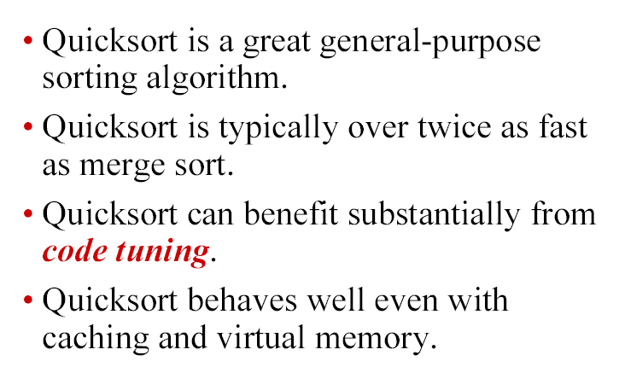
Quicksort in practice

